Slide 1
ObaaS Testing

Slide 2
OBaaS on Kubernetes Cluster
1. What is ObaaS? 2. ObaaS cloud deployment 3. ObaaS components and testing approach
4. Test cases 5. Demo
6. Q/A

Slide 3
1. What is Outbound as a services?
Outbound as a Service (ObaaS) is the next generation of Proactive Outreach Manager (POM), rewritten to be compatible with cloud-native architecture.
ObaaS has two main service groups: campaign and contact, which are responsible for handling outbound tasks. It operates entirely on the cloud, in this case Microsoft Azure.

Slide 4
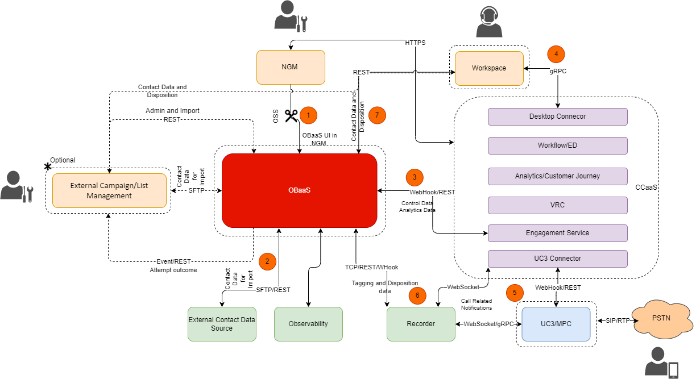
1. Solution Overview

Slide 5
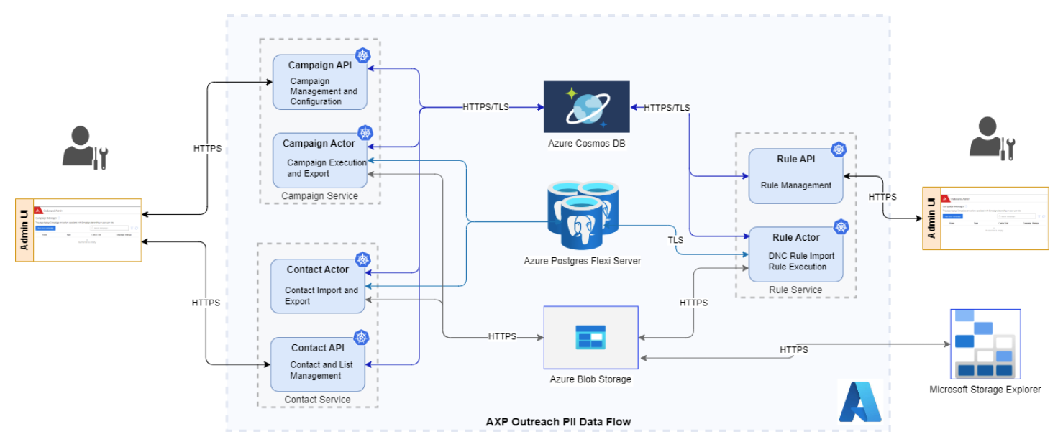
1. Data flow Diagram

Slide 6
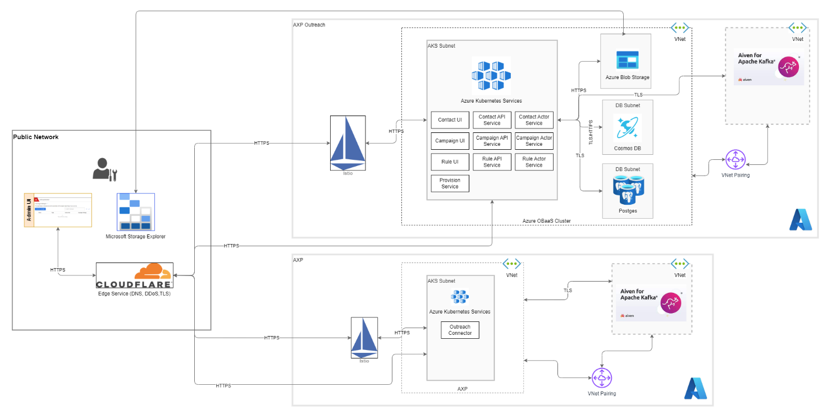
1. Network Diagram

Slide 7
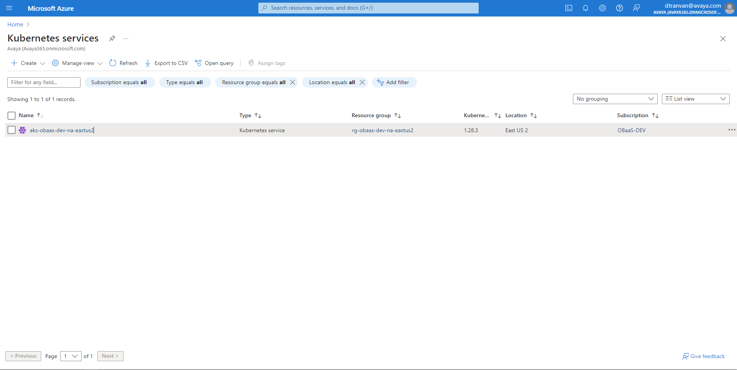
2. ObaaS cloud deployments
ObaaS is deployed on Azure with CI/CD, using a fully automated deployment solution to the Azure Kubernetes service.

Slide 8
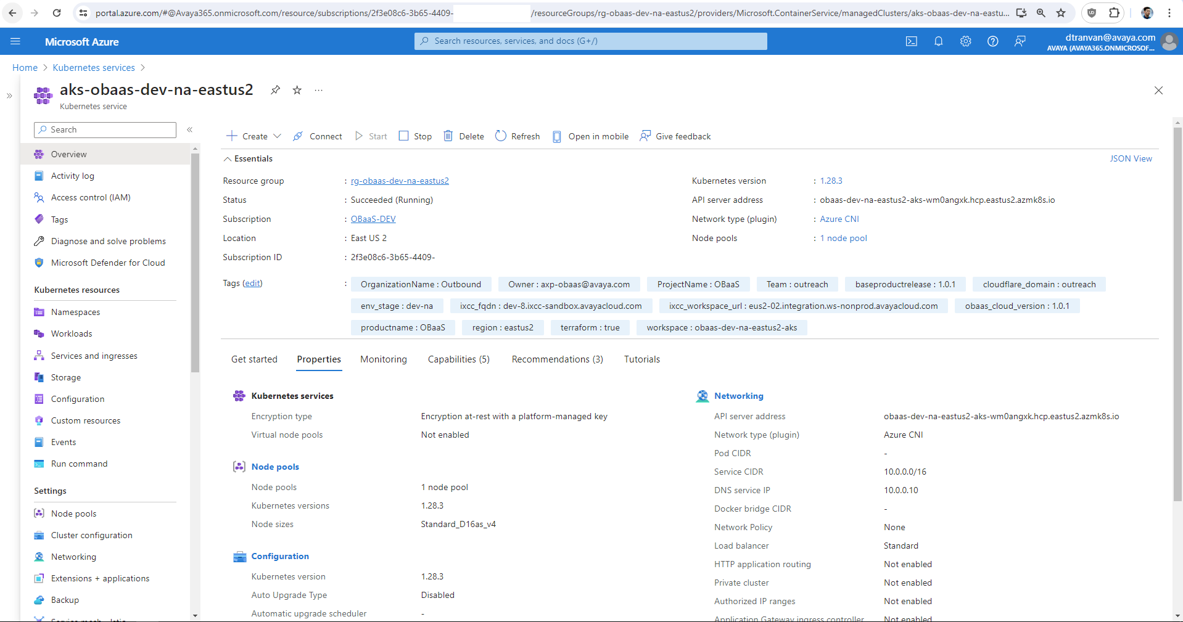
2. ObaaS cloud deployments

Slide 9
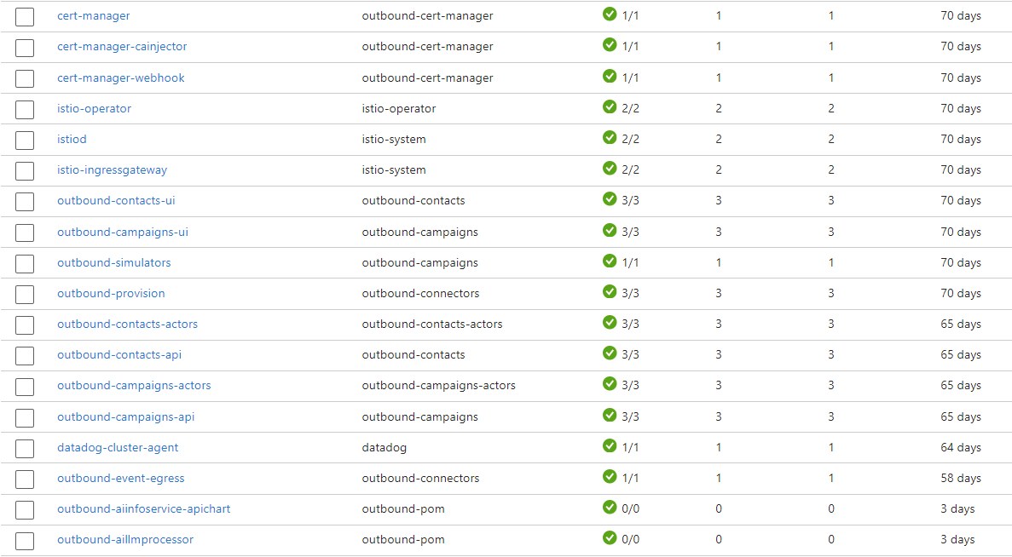
2. ObaaS cloud deployments

Slide 10
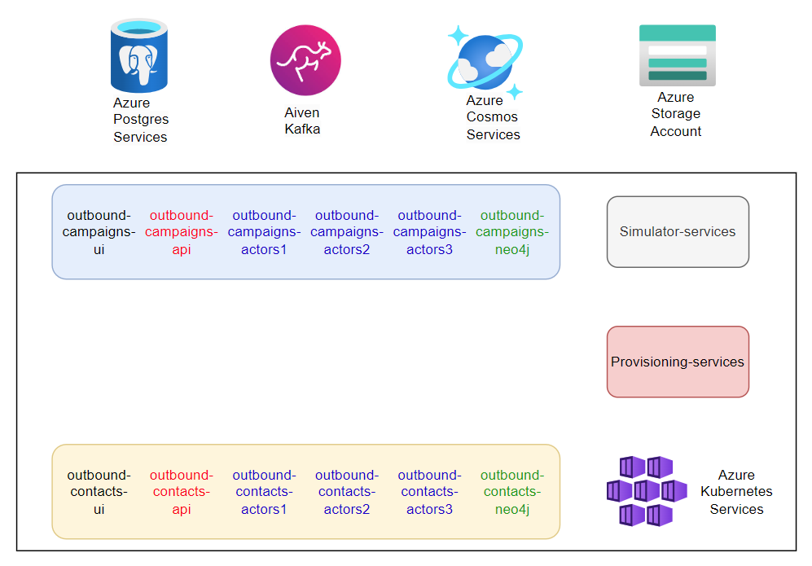
3. ObaaS components and testing approach

Slide 11
3. ObaaS components
Components
Pod :
outbound-campaigns-ui, outbound-campaigns-api (3), outbound-campaigns-actors (3-10)
outbound-contacts-ui, outbound-contacts-api (3), outbound-contacts-actors (3-10)
outbound-provision
outbound-simulators
Namespace: outbound-campaigns, outbound-contacts, outbound-connectors, outbound-campaign-actors, outbound-contacts-actors,outbound-simulator
Horizontal Pod Autoscaling (HPA): campaign-actors, contact-actors
Notes:
https://kubernetes.io/docs/tasks/run-application/horizontal-pod-autoscale/
https://viblo.asia/p/hpa-la-gi-auto-scaling-pod-bang-hpa-va-keda-ByEZkerA5Q0

Slide 12
3. Testing approach
Obaas design approach
Pod working :
Each pod runs independently
Each service can operate independently
If the ui service is down, it means the ui is not accessible but the backend service is still working normally. And vice versa.
The backend uses Spring Boot implementing the Akka framework. When we need to work with a large amount of task, the api will plan operations and assign them to processing actors. The actors will follow the plan and handle the requests.
When the api is down, the backend becomes inaccessible. Once the API is running, the backend will also be available to access.

Slide 13
3. Testing approach
Obaas design approach
Pod working :
The larger the number of actors, the more jobs can be performed in the queue.
If there is no actor then the job is pending, when the actor returns then the job will continue.
Campaign uses pace to determine the amount of processing, e.g. 40 SMS/s, 10 Calls/s
Contacts use maximum actor's capacity to process imported contacts.

Slide 14
3. Testing approach
Obaas design approach
HPA:
HPA enable for actors.
Start with 3 pods and maximum 10 pods.

Slide 15
3. Testing approach
Obaas design approach
Resources:
CPU, memory for each pod.
Monitor number of pod

Slide 16
4. Test cases
UI crashes, Backend still works
Backend crashes, UI sill works
The UI/API is broken and will automatically be replaced by a new instance (new pod), then the services will be accessible
Campaign service crashes, Contact service still works
Can create contact list when all actor pods are terminated.
Can create campaign when actor pods are terminated.
HPA off, contact actors = 3, run import 1000 contact lists with 10k contacts.
HPA on, start contact actor = 3, run import 1000 contact lists with 10k contacts.
HPA off, campaign actors = 3, pace = 40sms/s, run 1 campaign 10k contacts.
HPA off, campaign actors = 3, pace = 40sms/s, run 1000 campaign 10k contacts.
Notes:
7. Take a long time
8. Actors pods scale to 10, import faster
9. Take 250 seconds
10. Take more than 250 seconds

Slide 17
4. Test cases
HPA on, start campaign actors = 3, pace = 40sms/s, run 1000 campaign 10k contacts
Run 1 campaign, scale actor to 0, campaign stop sending sms, scale to 1, campaign start sending sms again.
Notes:
11. Take 250 seconds, actor pods 10

Slide 18
5. Demo

Slide 19
6. QA

Slide 20
THANK YOU !

Slide 21
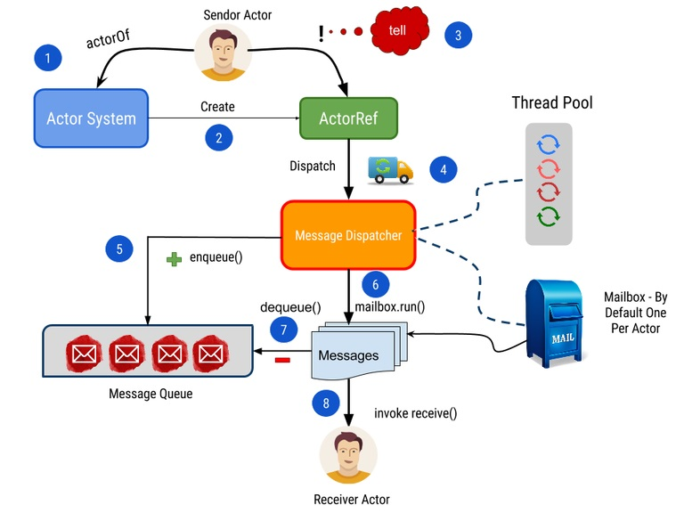
Akka Framework

